Slide 1


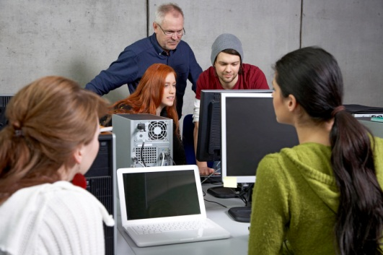

IT-oLogy is a non-profit collaboration of businesses, academic institutions and organizations dedicated to growing the IT talent pipeline, fostering economic development and advancing the IT profession.
IT-oLogy has 3 initiatives:
Promote IT
Teach IT
Grow IT
IT-oLogy works with K-12 schools to encourage the best and brightest young people and their parents to learn more about the IT profession.
In collaboration with IT-oLogy, companies work with colleges and universities on applied business research projects and experiential learning opportunities that strengthen and align classroom skills to current and future IT business needs.
IT-oLogy partners with IT professionals and their companies to provide
innovative and life-long learning and professional development
^{opportunities.}

Slide 3






























Corporate Partners
Notes:
3

Slide 4


























Academic Partners

Slide 5


Student as Professional

Slide 6
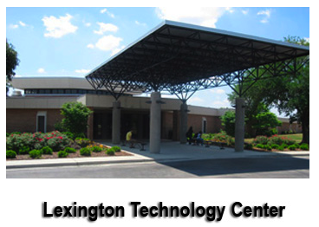

Student as Professional

Slide 7
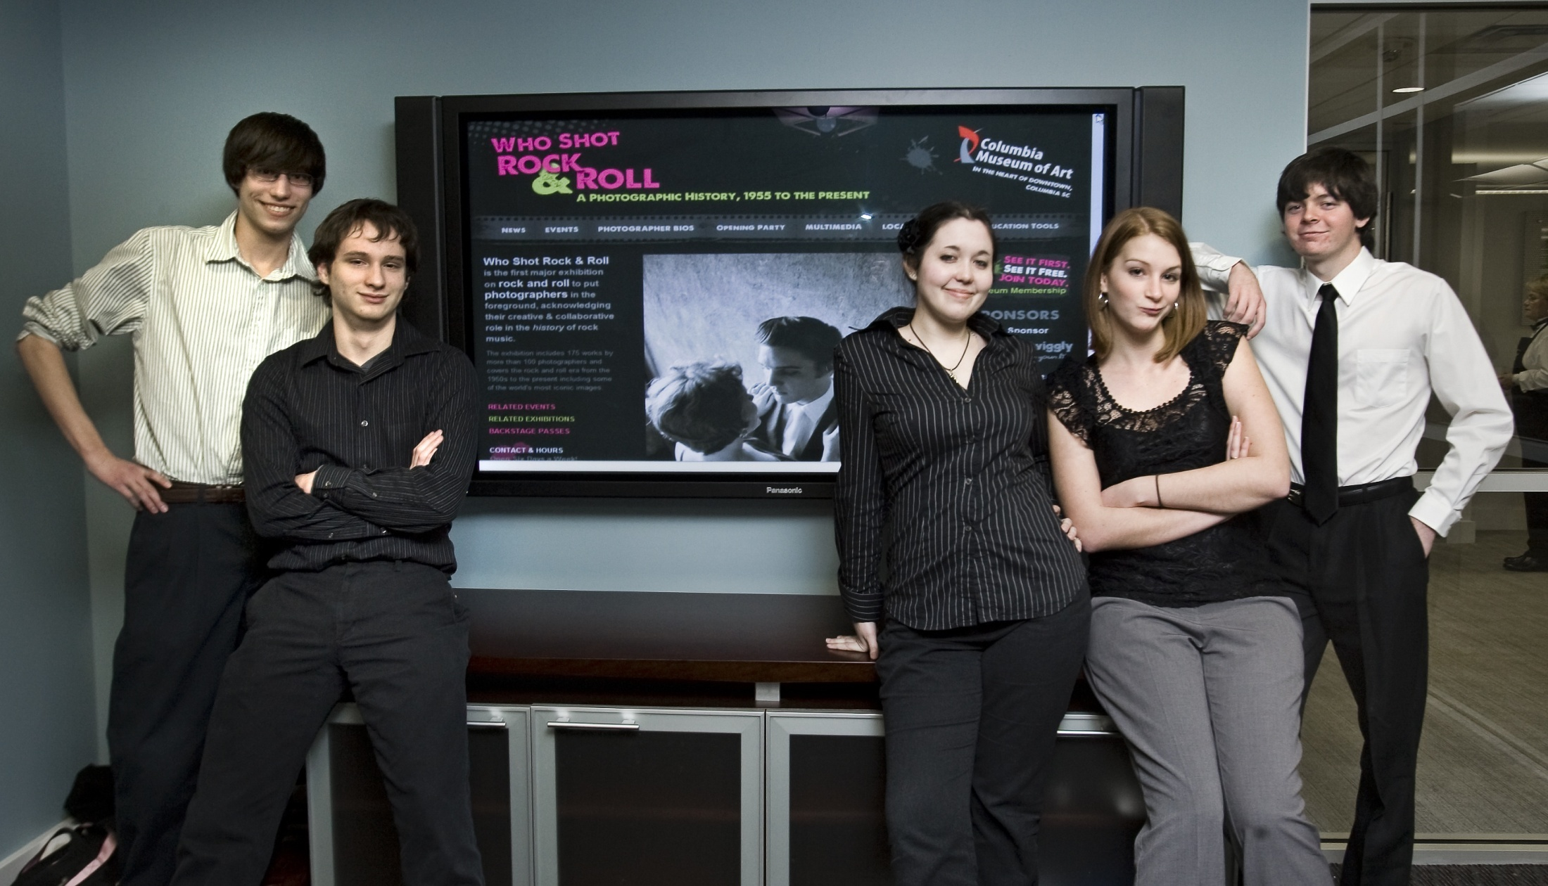
Student as Professional
Nov 2010 – Jan 2011
Team Members
Project Manager
Business Analyst
Designer
Developer/Programmer
Quality Assurance

Slide 8

Student as Professional
Finished Product
http://www.columbiamuseum.org/exhibitions/whoshotrock/index.php

Slide 9
Lessons Learned
Different Careers in IT
What it takes to complete a successful project
Unexpected things ALWAYS happen
Communication is key
I can do this for a living

Slide 10

1301 Gervais St. Columbia, SC http://open-it-lab.com

Slide 11
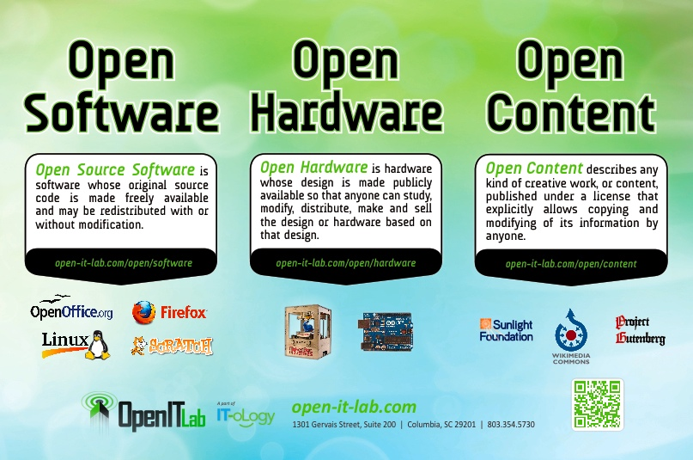

Slide 12
Awareness

Slide 13
Education
One Hour Lab Tour
Open 101 (2hr – Intro/Ad, 4 hr – Intro/Ad)
Open 101 for Teachers
Ubuntu 101 –Introduction and Advanced
Open 201 – Open Software in Depth
Open 202 – Open Hardware in Depth
System Administration 101 – OS included
OS From the Geospatial Perspective

Slide 14
Research and Development
Demonstrate that Open Source can be applied
Students, teachers/professors, IT professionals can join a project and contribute
Current project – Columbia Police Department
Make crime report information widely available
Web application
Mobile applications – Android, iPhone

Slide 15




Do you want to be a part of
?
Connect with us!
www.IT-oLogy.org
www.IT-oLogy-blog.org
IT-oLogy
IT_oLogy
IT-oLogy

Slide 16
1301 Gervais St. Columbia, SC http://open-it-lab.com
Todd Lewis
todd@posscon.org
803-240-1213

